Slide 1
Virtual Afwi Tyler Brunelle

Slide 2
Overview
Background
Goals
Merits / Impact
Design Specifications
Technologies
Milestones
Results
Challenges

Slide 3
Background
Virtual AFWI
Project Advisor
Tyler Brunelle
Dr. Hrishikesh Bhide

Slide 4
Goals
Players/Instructors: Easy access, simple UI, consistent enforcement of mechanics
Tutorial: Ease players into the game with simple tutorial

Slide 5
Intellectual Merits & Broader Impact
Merits
Impact
First attempt at a video game
Design of a turn-action system
Made in Python
Quicker learning across the nation
More accessible to potential players
Improved and standard understanding of the game come special AFROTC training events

Slide 6
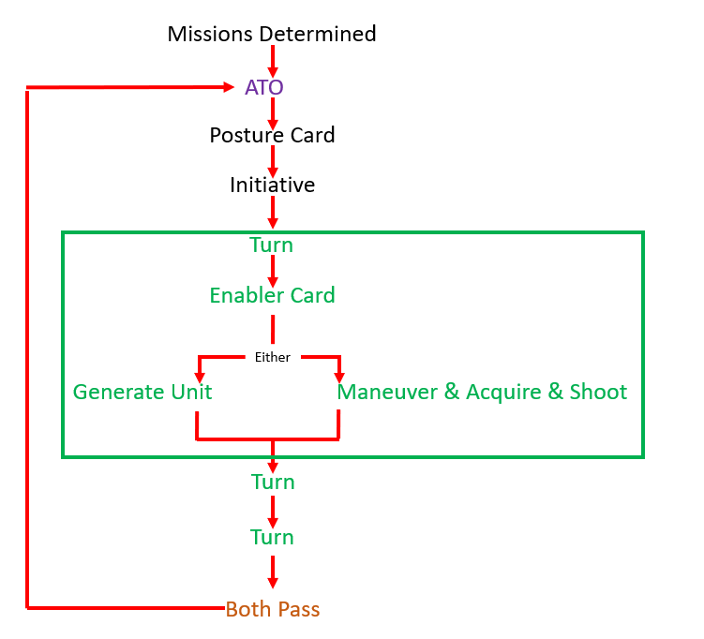
Design Specifications
High-Level Modules
UI
Rules Engine
Game State
Data Assets
Key Constraints
Accuracy to Rules
Clear UI for Hidden Info
Demo at Expo

Slide 7

Technologies
Python
UI
Pygame
Data / Assets
JSON/CSV

Slide 8
Milestones
Project Advisor Assessments
12/7/25
Spring Check-In
1/28/26
Expo
4/7/26

Slide 9
Results
Achieved
Game Loop / Turn System
Board Rendering
Token Placement
In Progress
Fog-of-War Mechanics
MAS Mechanics
Remaining
Scoring & Victory Conditions
Tutorial
QA & Bug Fixes

Slide 10
Challenges
Complex Rules
Translating the complex rules of the game to a streamlined program
Created a basic rules checklist and mapped that to the machine
Hidden Information (Fog-of-War Mechanic)
Cards appear hidden or facedown when initially played, later action reveals them to opponent
Working now on reveal interaction
Asset/Data Organization
Provided a lot of unorganized resources
Cleaned up storage and refined asset management

Slide 11
Summary
Background
Goals
Merits / Impact
Design Specifications
Technologies
Milestones
Results
Challenges

